Slide 1

PACE Survey 2024

Slide 2

What are we talking about?
Market Update
Wellington / Change of Government
EA market
Survey results
Extended Q&A
Notes:
Set the scene – questions welcome – make it interactive

Slide 3
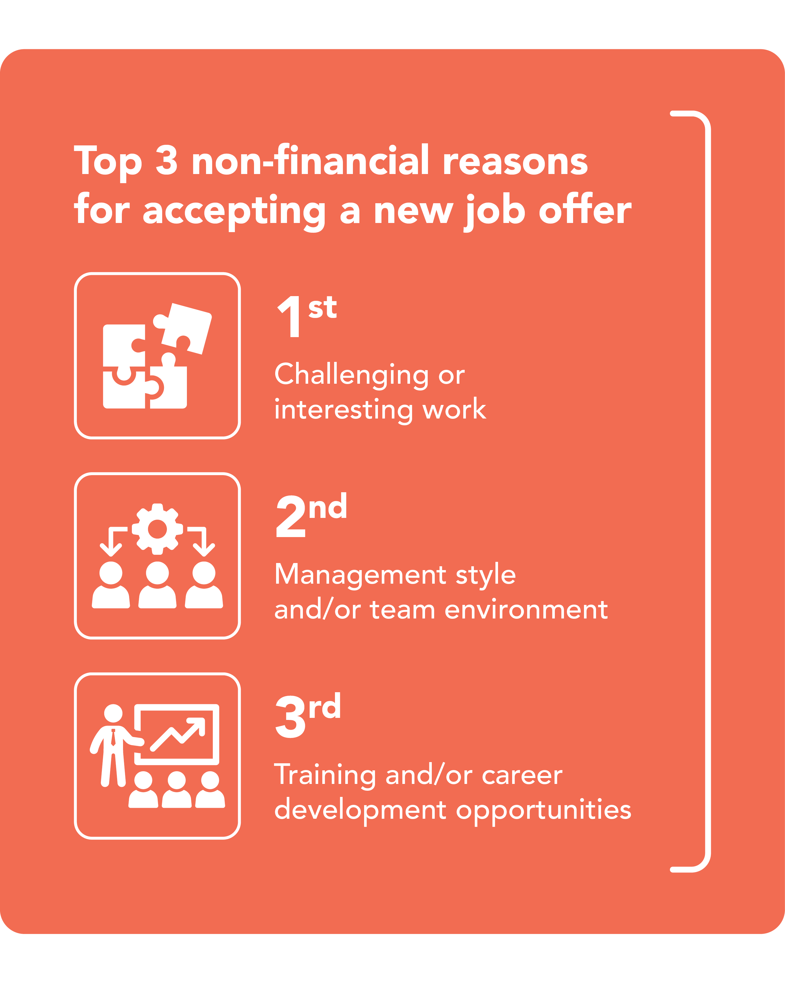
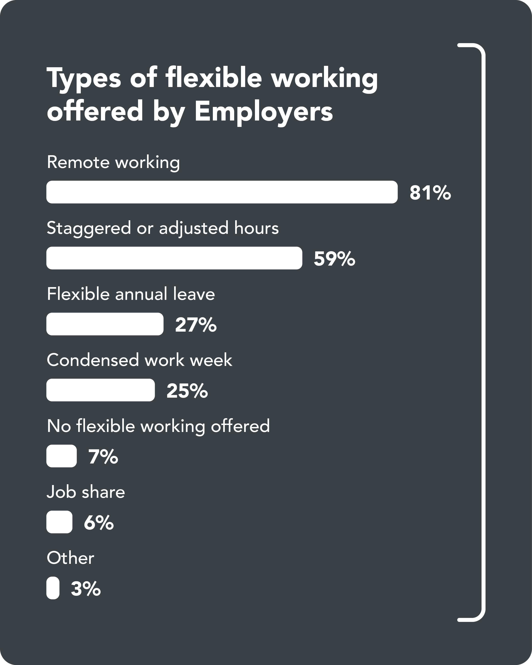
Market Update
EMR 2024,
what is happening?
Unemployment rate increasing
Flexibility decreasing
Doing more with less
Employers looking for “Stickability”
Employee retention is a big thing
Notes:
Unemployment rate 4.6%
To discuss later Flexible working and changes of responsibilities

Slide 4

Change of Government
What has this meant for Wellington?
Notes:
Reduction of temporary hiring, reduction of permanent hiring, job ads on seek down 30%
Uncertainty for everyone, increase to number of candidates applying to jobs
Increase to the price of coffee – cost of living crisis
It’s quiet
Hiring has almost stopped, especially in the temp space
Fear is driving the market + recession
Projects are on hold
Clients are unsure about future
Expecting a surge in May – Budget/ July start of new financial year
Candidates are cautious, not moving and taking perm roles

Slide 5
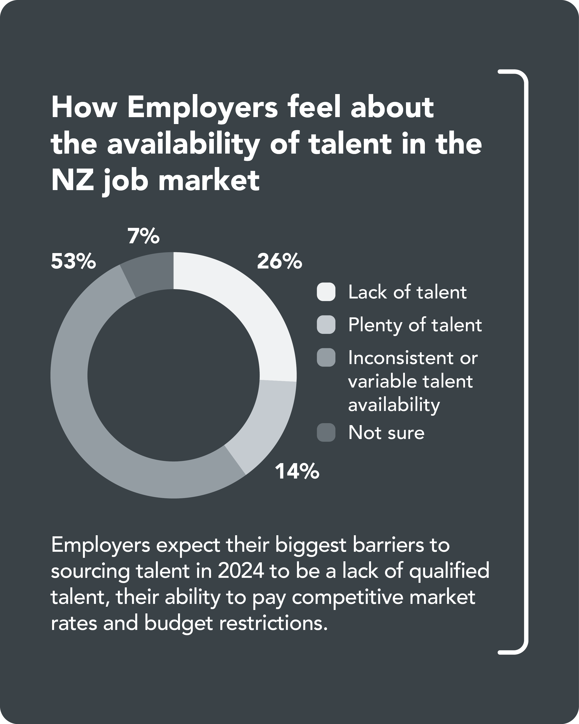
Employers looking for “Stickability”
Skills
Attitude
Willingness to learn
Culture Fit
Notes:
There has been a shift from we need anyone to raising the bar to getting 10 out of 10

Slide 6
Alternative Career paths more limited
Last year, as a result of skills shortages we saw PA’s and EA’s moving into alternative career paths such as project coordinator or office manager roles. This progression is now more limited.

Slide 7
EA Market
Trends we’re seeing
Salaries increases are ad-hoc
Perm and FTC in demand vs Temp
Temps that usually only temp now considering perm work
Board/Governance secretary experience in demand, previously minutes might be a task that was delegated or passed over now it is non-negotiable
Notes:
Temps have been out of work

Slide 8
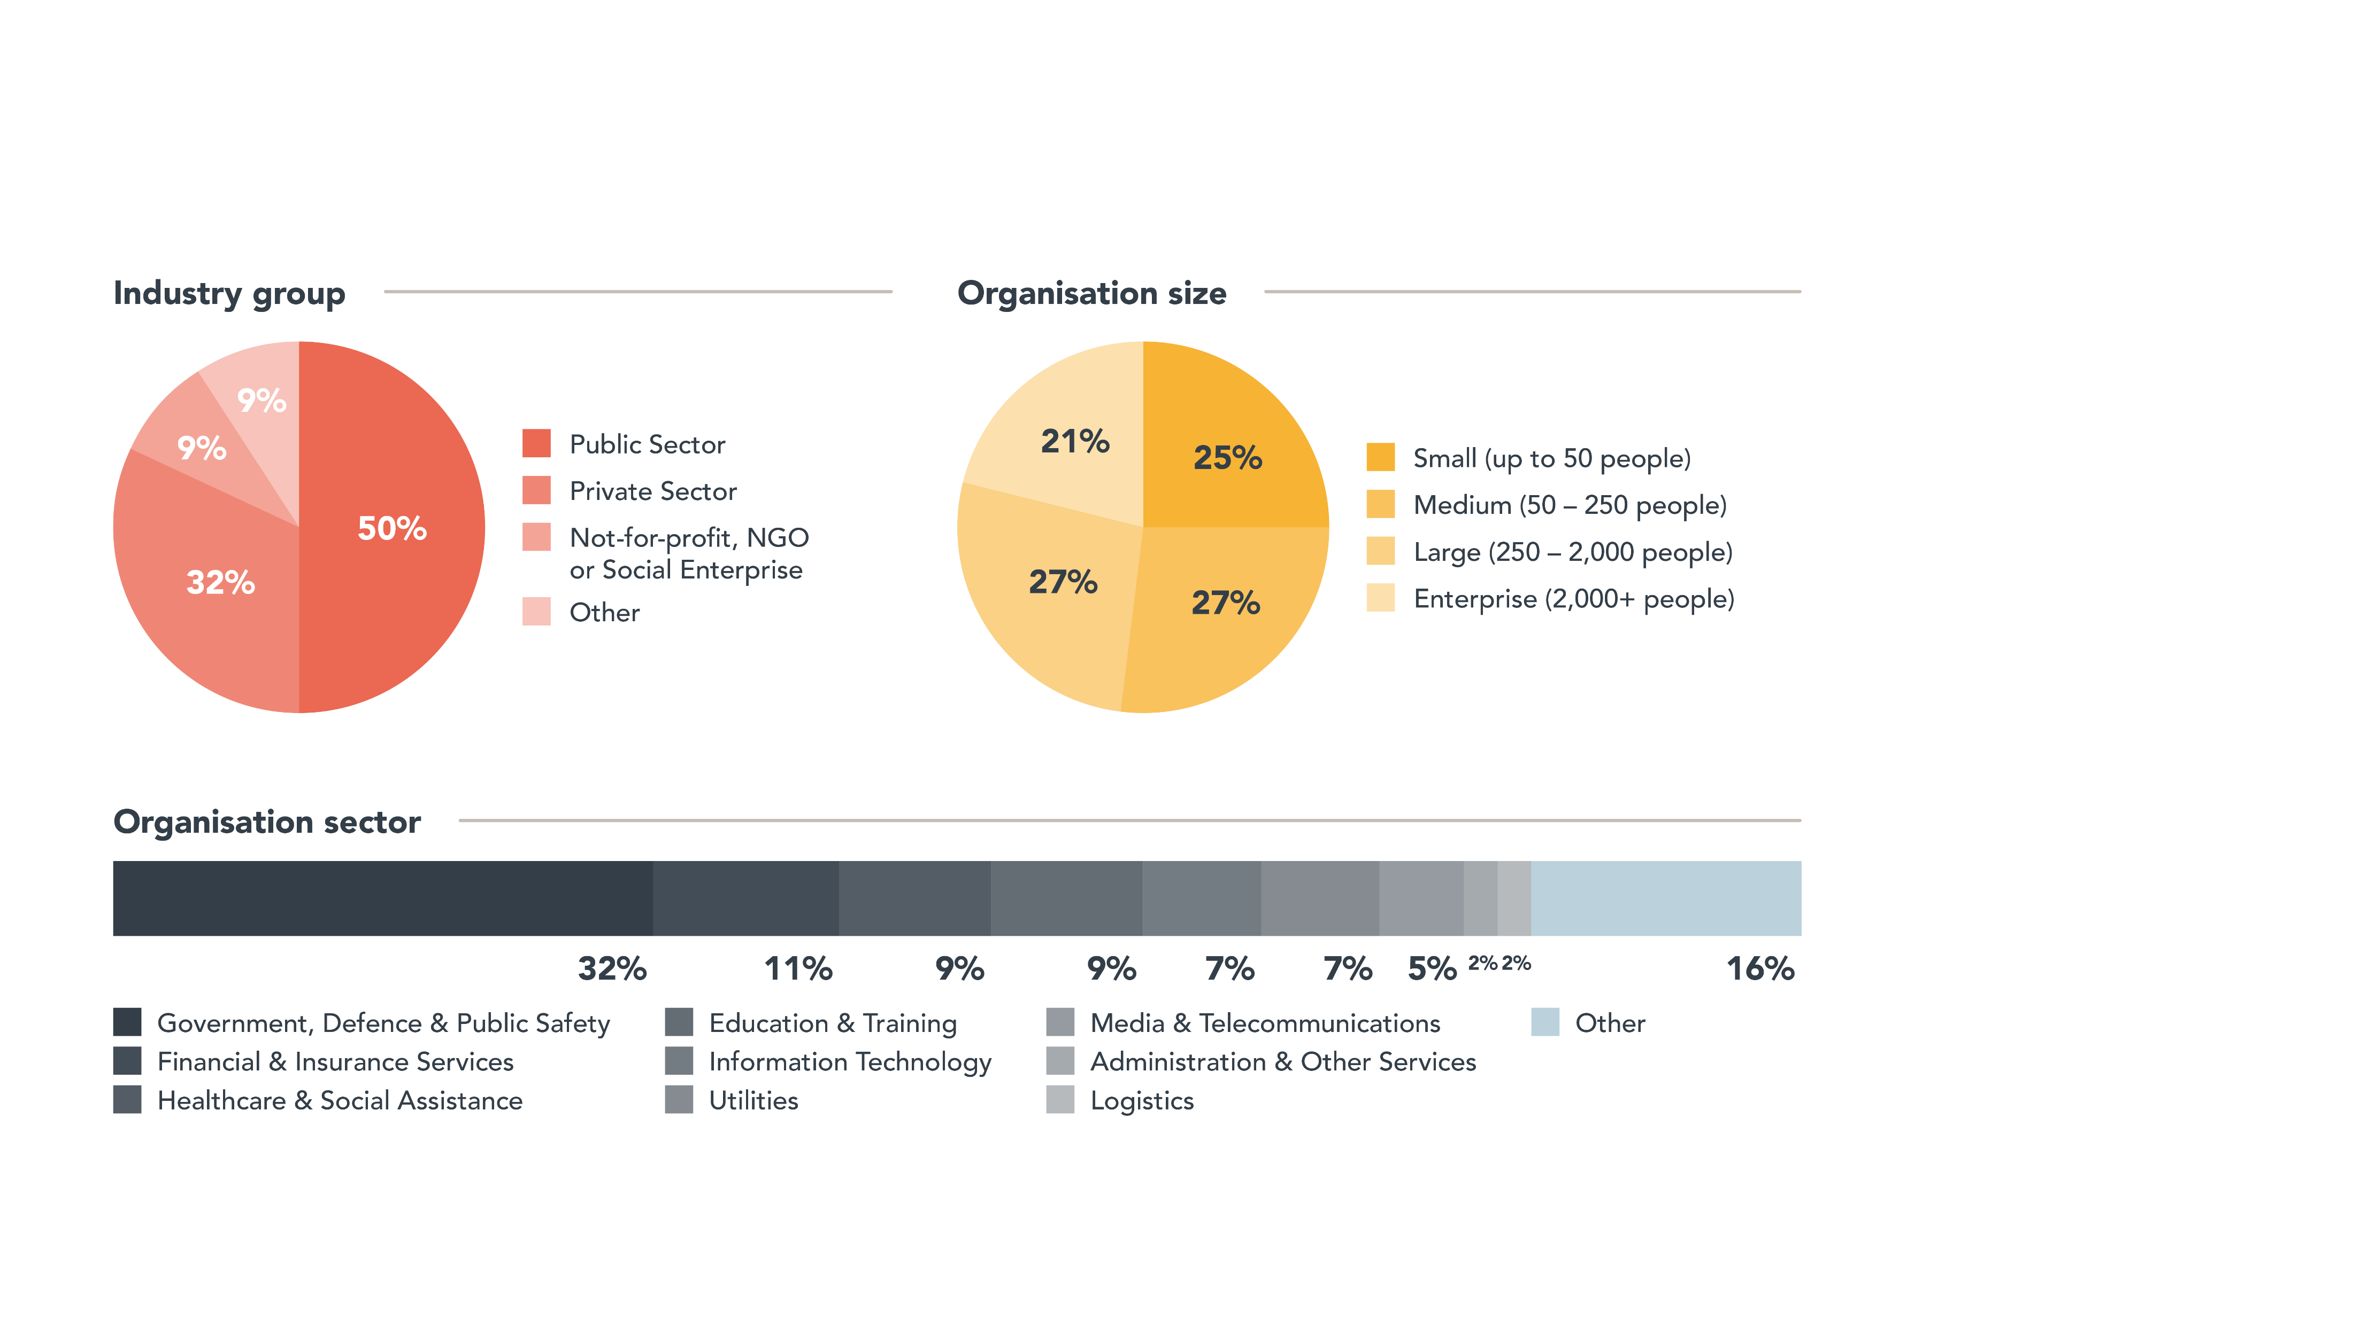
Survey Results
Notes:
A good spread of respondants across private and public sector and even split across small, medium, large and enterprise organizations.
1/3 are government

Slide 9
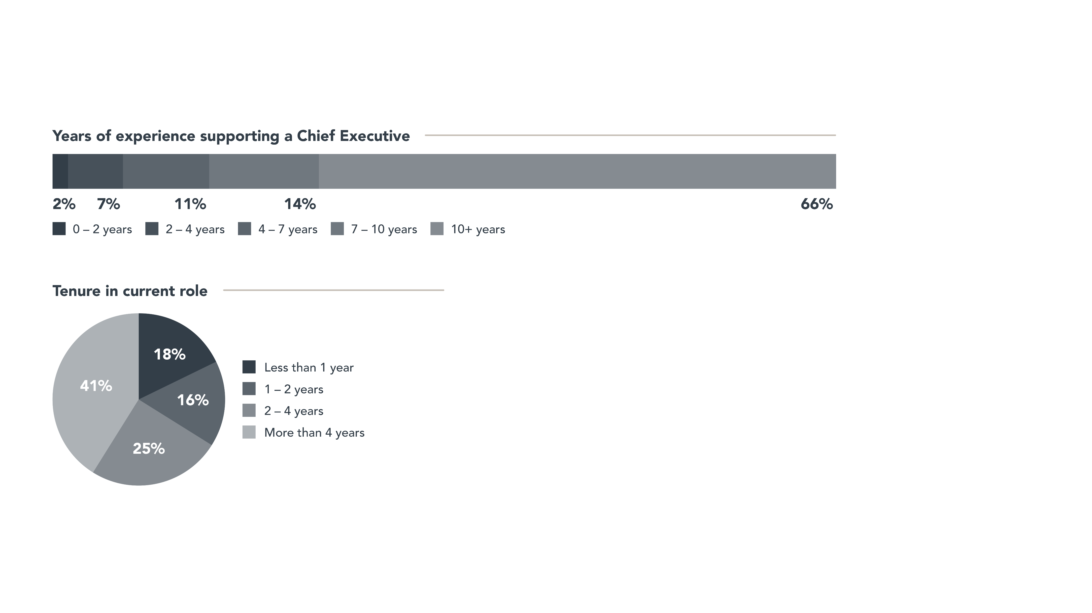
Survey Results
Notes:
80% of respondents have 7 years or more experience
Majority have been in their roles for at least 2 years

Slide 10
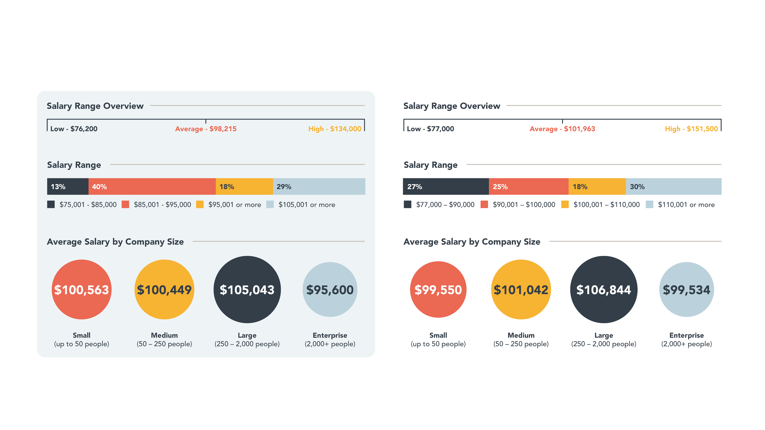
Salaries have gone up again!
2023
2024

Slide 11
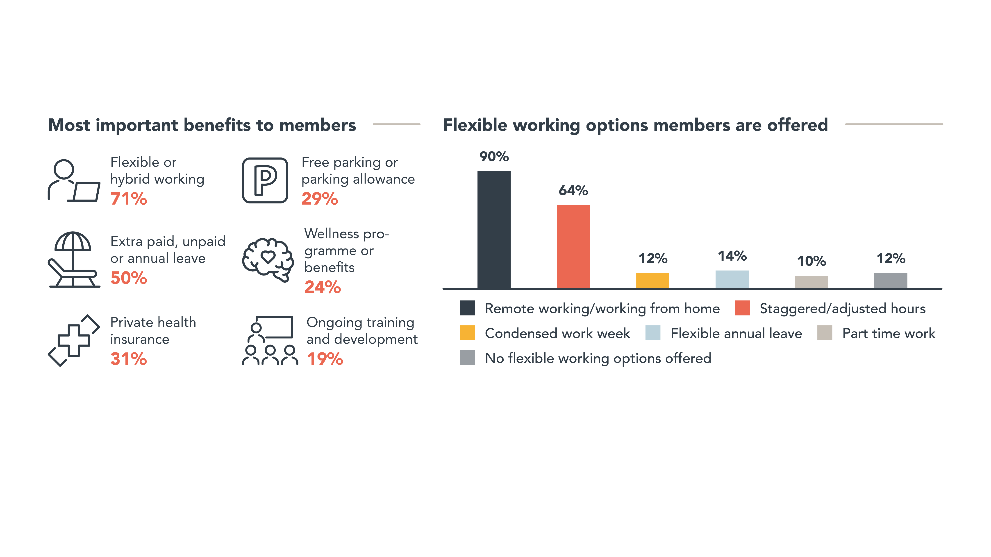
Flexible Working & Benefits

Slide 12
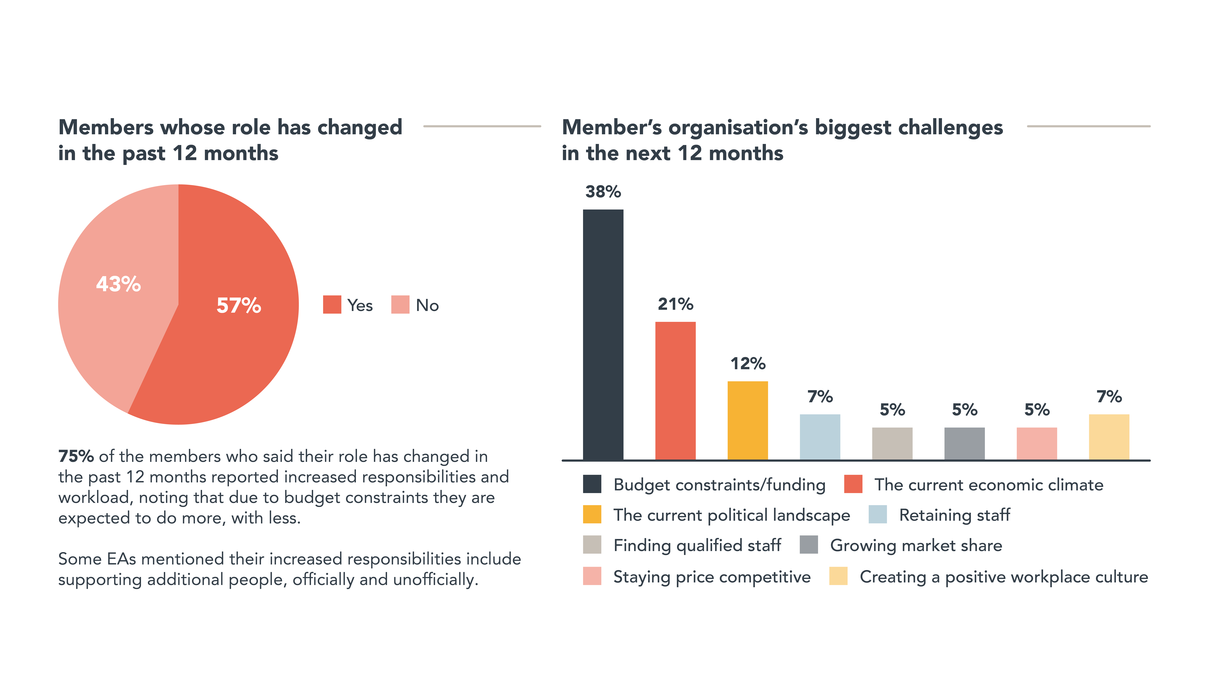
Evolving Roles & Challenges

Slide 13
What does the rest of 2024 look like??

Slide 14

Questions?
Thank you.

